Slide 1

Amazon Review Sentiment Analysis
By:
Abhishek Thummanapeli
01/09/2025
Ironhack

Slide 2


The Problem
Too much data
Hidden insights: Valuable feedback on product features, quality issues, and customer satisfaction is buried in this unstructured text.
The need for a solution: We need a scalable, automated way to understand customer sentiment and extract actionable insights.

Slide 3

The Objective (Solution)
To build an automated system that processes raw Amazon reviews.
Uses Natural Language Processing (NLP) and Machine Learning to go from unstructured text to structured, valuable data.
Divided into three parts:
Sentiment Analysis
Product Clustering
Text Summarization and app deployment

Slide 4
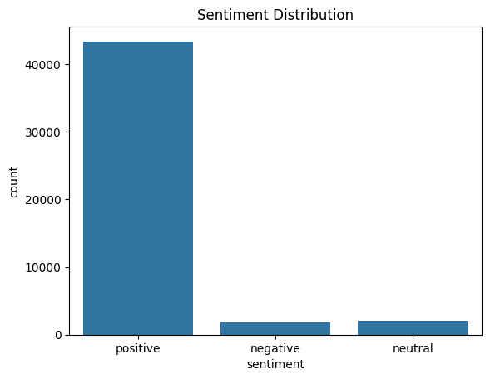
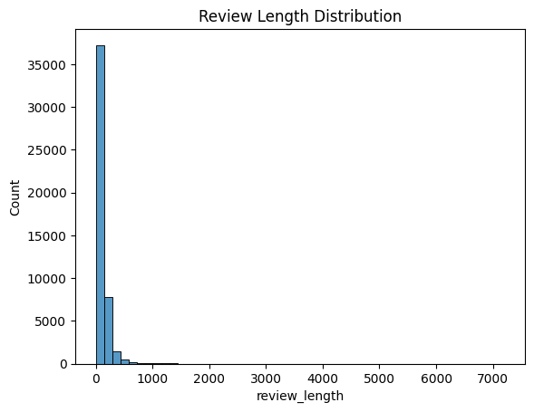
PART 1
Data Processing and Sentiment Analysis
Load and prepare the raw data
Fine tune a DistilBERT model
Save the model and dataset with review sentiment

Slide 5
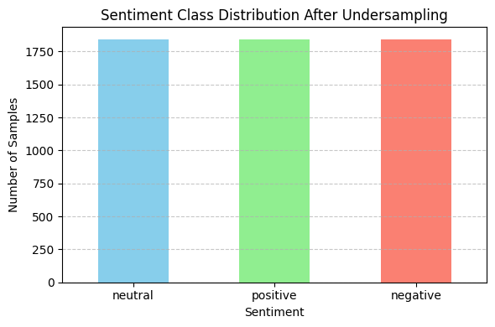
Balanced dataset after Undersampling

Slide 6
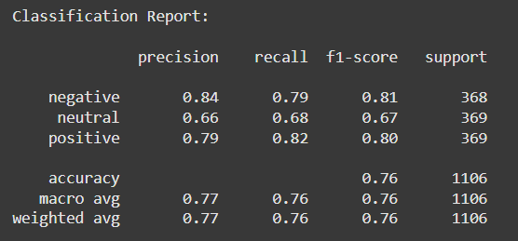
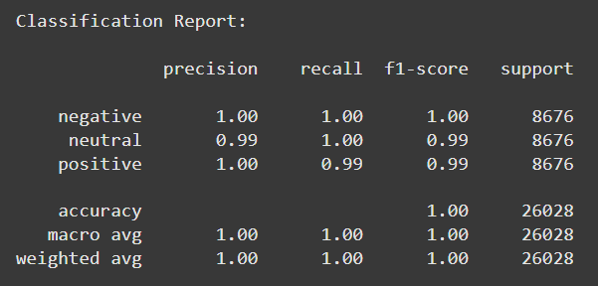
Undersampling
Oversampling

Slide 7
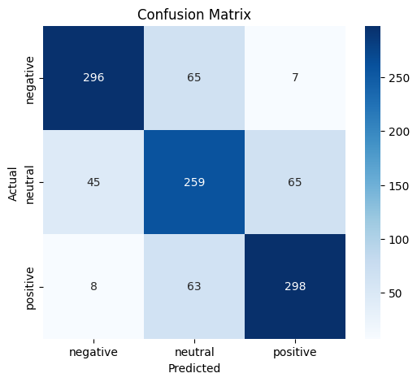
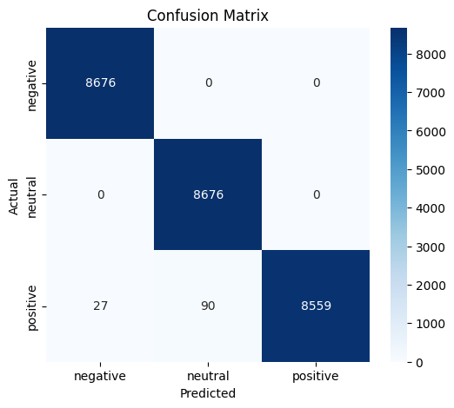
Undersampling
Oversampling

Slide 8
Product Clustering
Part 2
Meaningful Categorisation
Cluster 0
Cluster 1
Cluster 2
Cluster 3
Cluster 4
Miscellaneous Electronics
E-readers and Tablets
Smart Home Devices
Branded Batteries
General Batteries
all-MiniLM-L6-v2 model
K - Means Clustering
Save the data

Slide 9
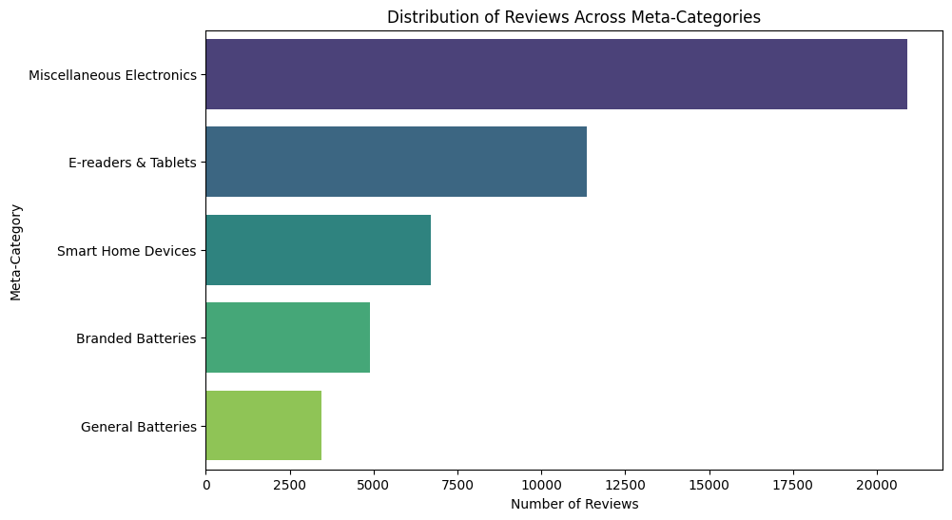
Data Visualisation

Slide 10
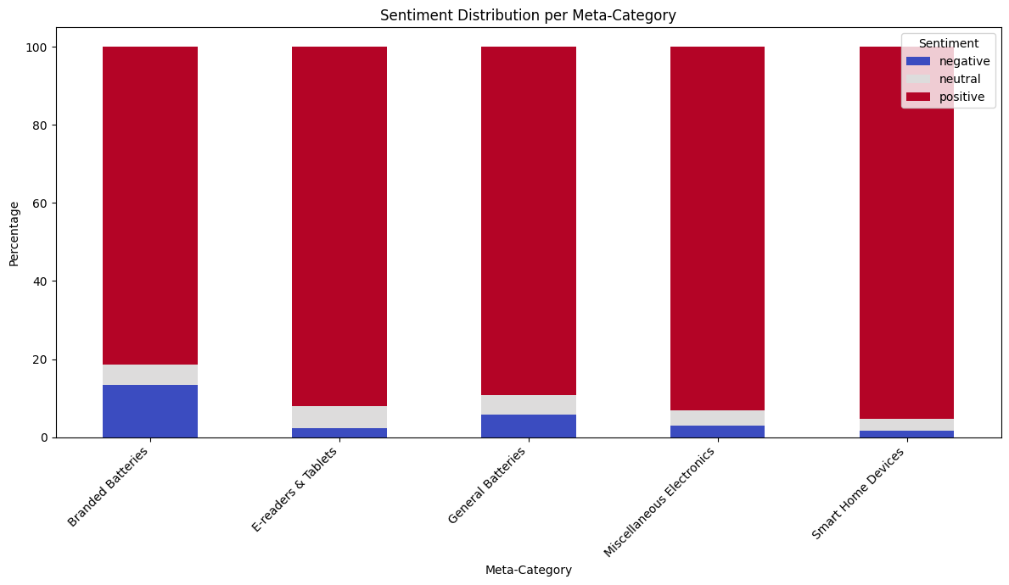
Data Visualisation

Slide 11


PART 3
Text Summarization using T5
Gradio web app deployment
This helps us understand why a product is loved or disliked

Slide 12
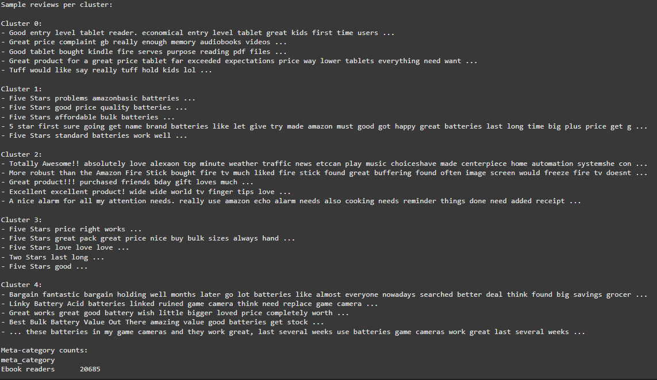

Slide 13



